Slide 1





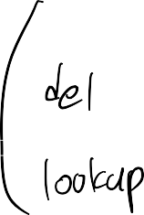





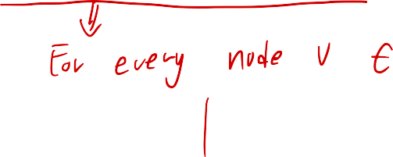
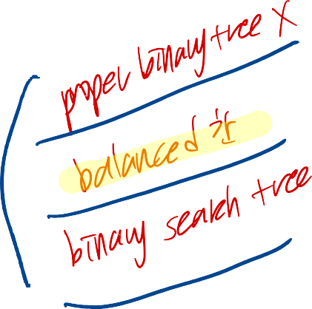





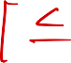

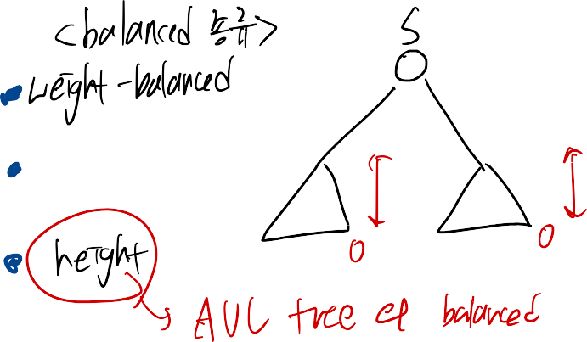


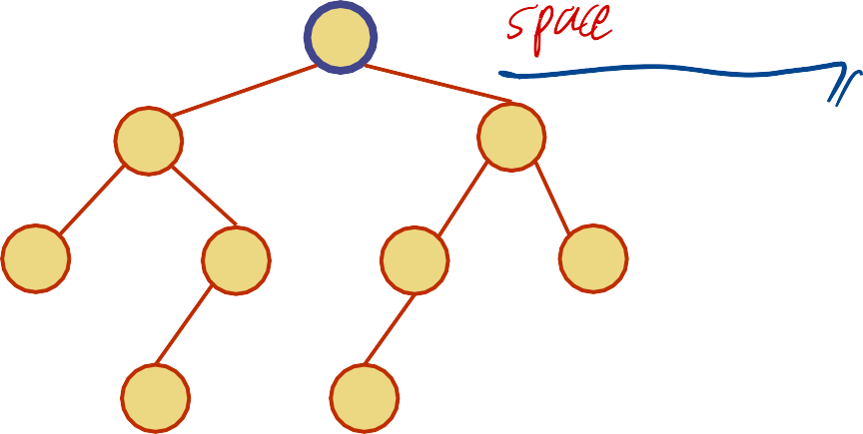
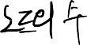
AVL Trees
6
3
11
1
5
9
15
4
8
1

Slide 2






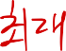




AVL Tree Definition
AVL trees are balanced
An AVL Tree is a binary search tree such that for every internal node v of T,
6
3
3
2
11
2
1 0
5 1
-1
9
1
-1
15
0
-1
-1
4
0
8
0
the heights of the children of v can
differ by at most 1
An example of an AVL tree where the heights are shown next to the nodes:
2

Slide 3







n(2)
3
Height of an AVL Tree
2
4
n(1)
5
F act: The heig h t o f a n A V L tre e s t o r i n g n keys is O(log n).
Proof: Let us bound n(h): the minimum number of nodes of an AVL tree of height h.
We easily see that n(1) = 2 and n(2) = 4
For n > 2, an AVL tree of height h contains the root node, one AVL subtree of height n-1 and another of height n-2. That is, n(h) = 1 + n(h-1) + n(h-2)
Knowing n(h-1) > n(h-2), we get n(h) > 2n(h-2). So
n(h) > 2n(h-2), n(h) > 4n(h-4), n(h) > 8n(n-6), … (by induction),
n(h) > 2^{i}n(h-2i)
Solving the base case we get: n(h) > 2 ^{(h+1)/2}
Taking logarithms: h < 2log n(h) -1
Thus the height of an AVL tree is O(log n)
3

Slide 4

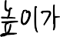
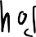

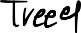

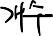
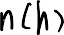



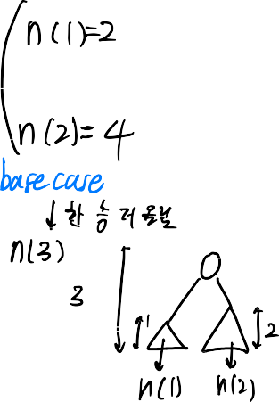


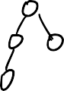
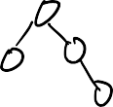
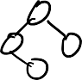

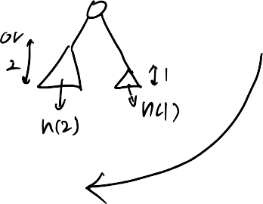
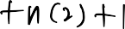
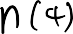
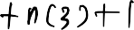


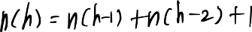
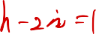


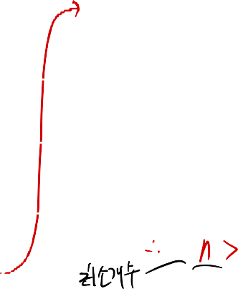
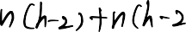

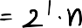
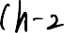

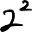
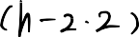
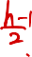
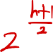
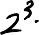
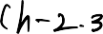
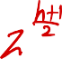
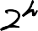
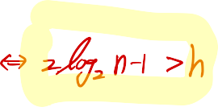
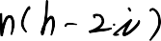


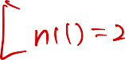

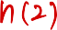
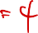



Slide 5
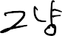

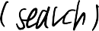



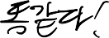




Insertion
Insertion is as in a binary search tree Always done by creating a leaf node.
Example:
44
44
17
78
17
78
c=z
a=y
32
50
88
32
50
88
48
62
48
62
b=x
54
w
before insertion
after insertion
4

Slide 6

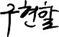

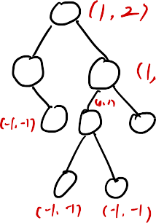

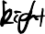

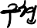









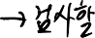
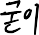
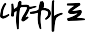








































Slide 7












Slide 8





















Slide 9



















Slide 10




















Slide 11
























Slide 12


Trinode Restructuring
let (a,b,c) be an inorder listing of x, y, z
perform the rotations needed to make b the topmost node of
the three
(other two cases
case 2: double rottion (a right rotation about c,
then a left rotation about a)
a=z
are symmetrical)
a=z
b=y
c=y
T
T₀
0
b=x
c=x
T₁
b=y
T₃
b=x
T
T
T₁
T₂
2
3
a=z
c=x
a=z
c=y
case 1: single rotation (a left rotation about a)
T₀
T₁
T₂
T₃
T₀
T₁
T₂
T₃
5

Slide 13














Insertion Example, continued
 |  | 5
 | 2 17 | 44 2 y |  | z 78 | 6₄ | 7 1
 | 32 | ₁ 50 1 | ₂ 4 | x |  | 88
 |  | 48 ₁ 3 | 62 | 5
 | unbalanced... | 54 T₀ T₁ 2 ...balanced | 17 | T₂ 1 32 | 44 | T₃ 4 ₁ 1 48 | 2 | 2 50 | y | 3 3 1 54 | 4 62 | x 5 | _{z} 6 78 | 2 | 7 88 | 1
1
3
T₂
T₀
T₁
T₃
6

Slide 14


















Restructuring
(as Single Rotations)
Single Rotations:
a = z
single rotation
b = y
b = y
a = z
c = x
c = x
T₀
T₃
T₁
T₃
T₀
T₁
T₂
T₂
c = z
single rotation
b = y
b = y
a = x
c = z
a = x
T₃
T₃
T₀
T₂
T₂
T₁
T₀
T₁
7

Slide 15
























Restructuring
(as Double Rotations)
double rotations:
a = z
double rotation
b = x
c = y
a = z
c = y
b = x
T₀
T₂
T₂
T₃
T₀
T₁
T₃
T₁
c = z
double rotation
b = x
a = y
a = y
c = z
b = x
T₀
T₂
T₃
T₂
T₃
T₁
T₀
T₁
8

Slide 16







Removal
Removal begins as in a binary search tree, which means the parent w of the node removed may cause an imbalance.
Example:
44 44
17
62
17
62
32
50
78
50
78
48
54
88
48
54
88
before deletion of 32
after deletion
9

Slide 17
















Slide 18






















Slide 20





Rebalancing after a Removal
Let z be the first unbalanced node encountered while travelling up the tree from w. Also, let y be the child of z with the larger height, and let x be the child of y with the larger height
We perform restructure(x) to restore balance at z
As this restructuring may upset the balance of another node higher in the tree, we must continue checking for balance until the root of T is reached
a=z
62
44
w
b=y
44
78
17
62
c=x
17
50
88
50
78
48
54
48
54
88
10

Slide 21










AVL Tree Performance
a single restructure takes O(1) time
using a linked-structure binary tree
find takes O(log n) time
height of tree is O(log n), no restructures needed
put takes O(log n) time
initial find is O(log n)
Restructuring up the tree, maintaining heights is O(log n)
erase takes O(log n) time
initial find is O(log n)
Restructuring up the tree, maintaining heights is O(log n)
11

Slide 22
AVL Tree Performance
a single restructure takes O(1) time
using a linked-structure binary tree
find takes O(log n) time
height of tree is O(log n), no restructures needed
put takes O(log n) time
initial find is O(log n)
Restructuring up the tree, maintaining heights is O(log n)
erase takes O(log n) time
initial find is O(log n)
Restructuring up the tree, maintaining heights is O(log n)
11

